Slide 1
ALPhA Week 12: (4/5/19 – 4/12/19)
Gray Selby
AT-TPC Alpha – Alpha Classification

Slide 2
Finally Plotting Events The following are all of Event 1 using an increasing charge threshold value

Slide 3
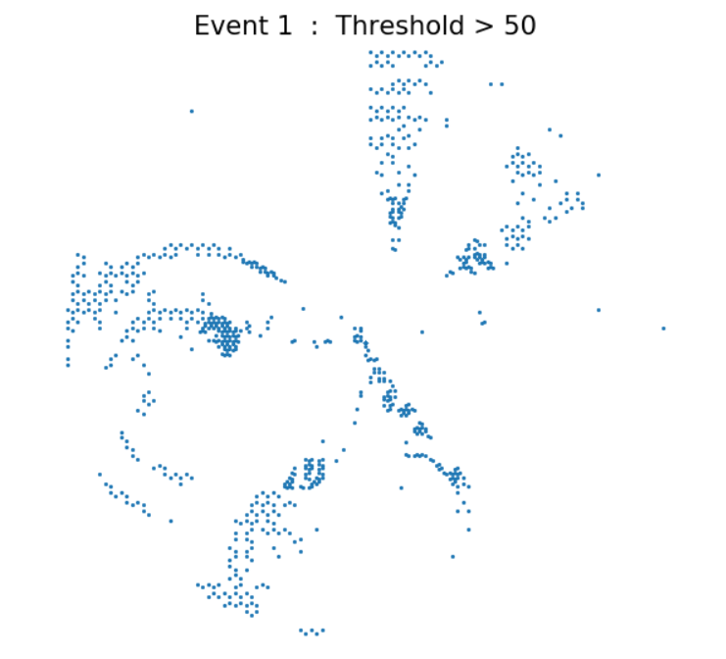

Slide 4
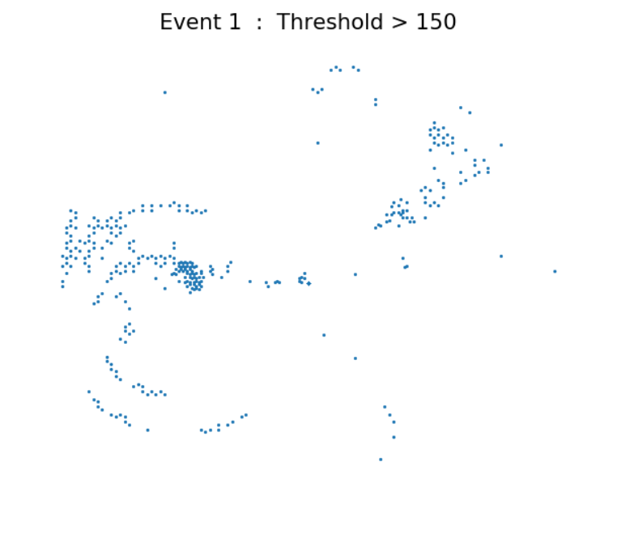

Slide 5
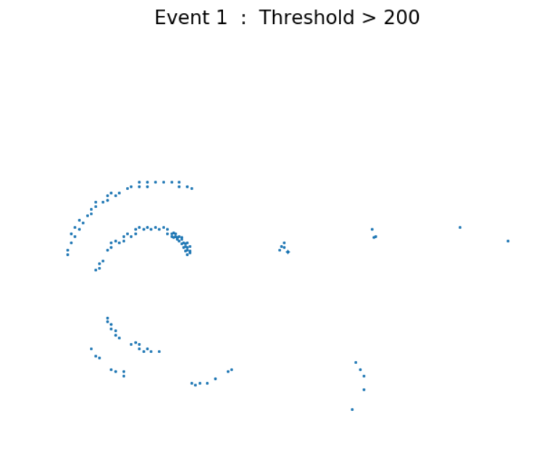

Slide 6
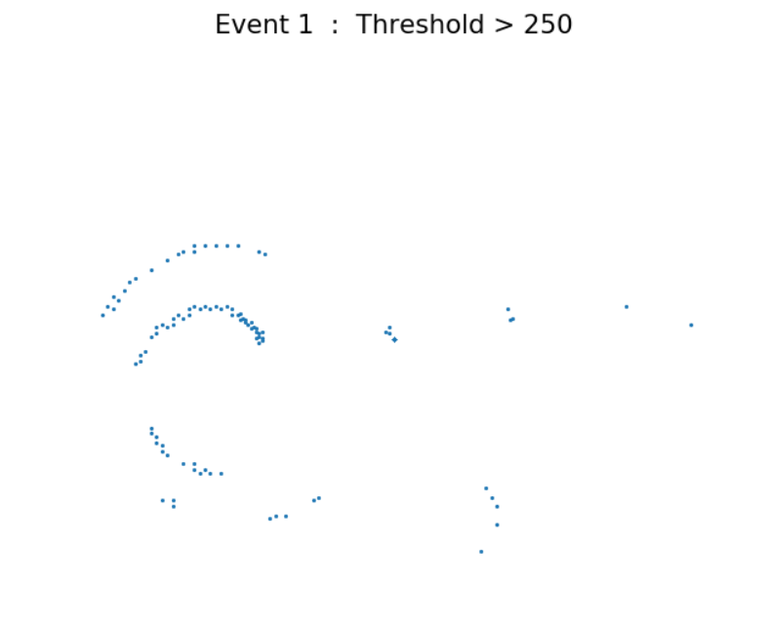

Slide 7
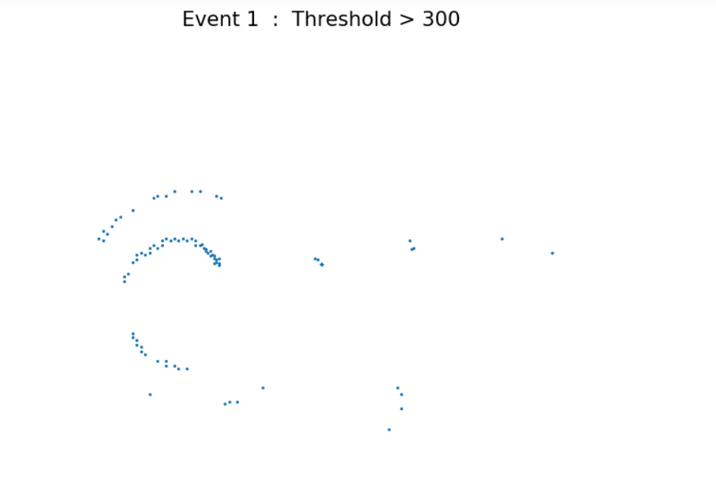

Slide 8
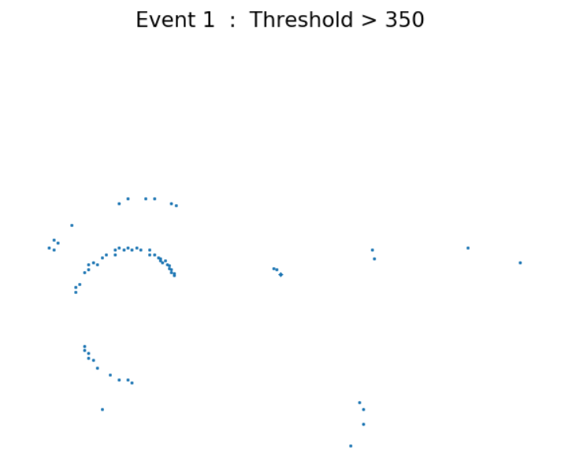

Slide 9
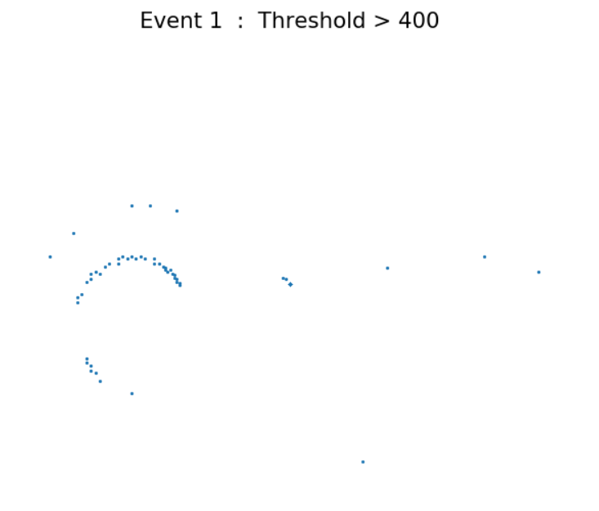

Slide 10
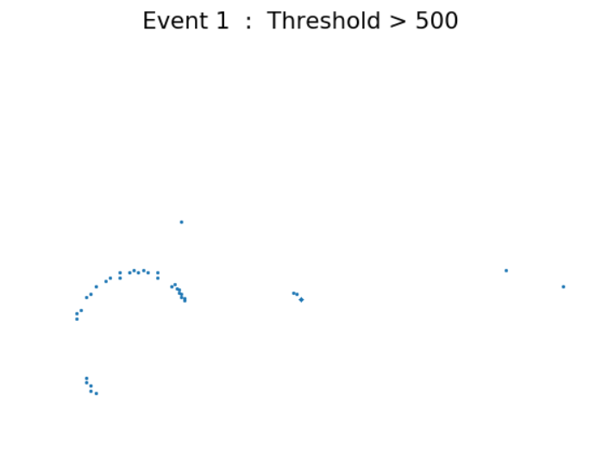

Slide 11
The following are a number of events with charge thresholds of 50, 150, and 200

Slide 12
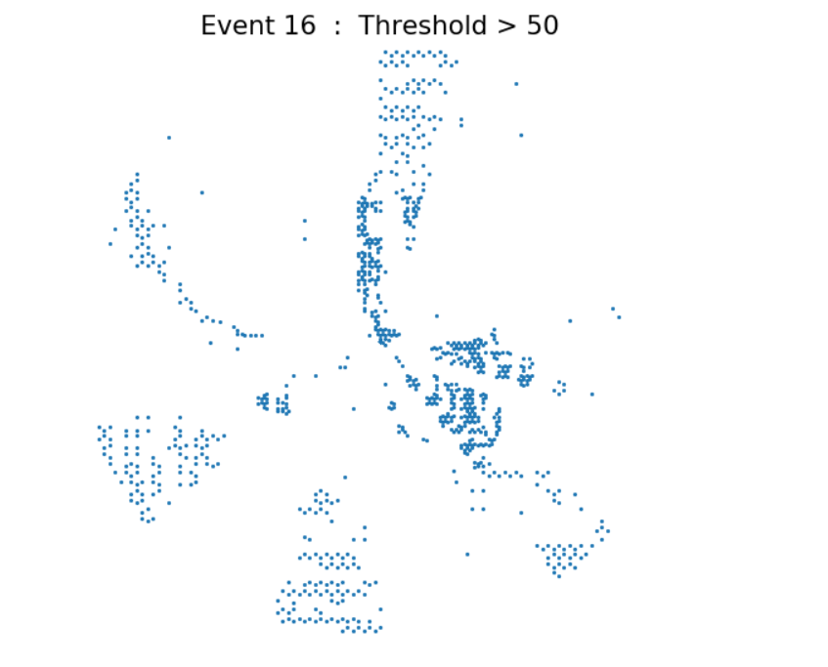
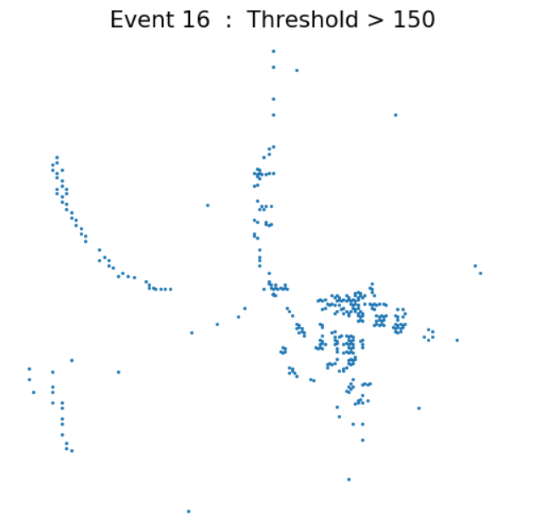
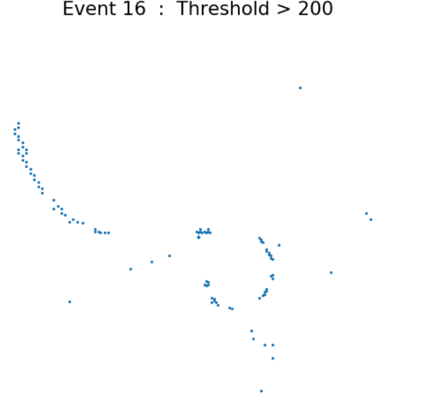

Slide 13
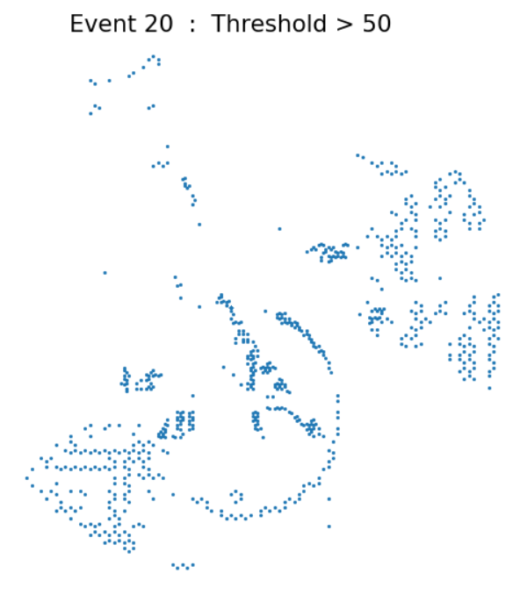
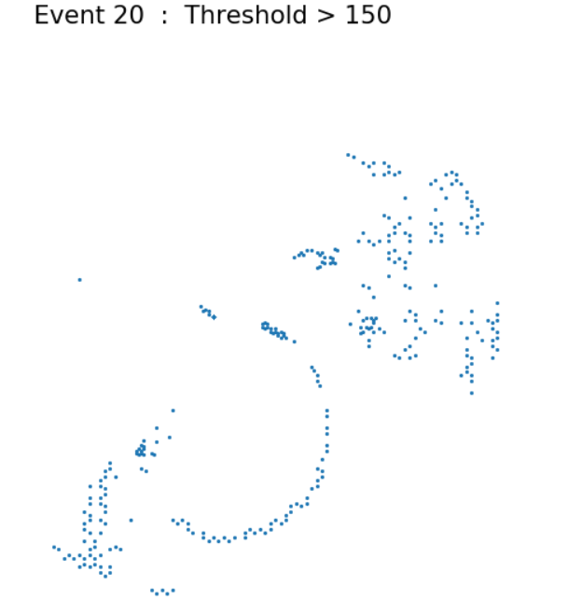
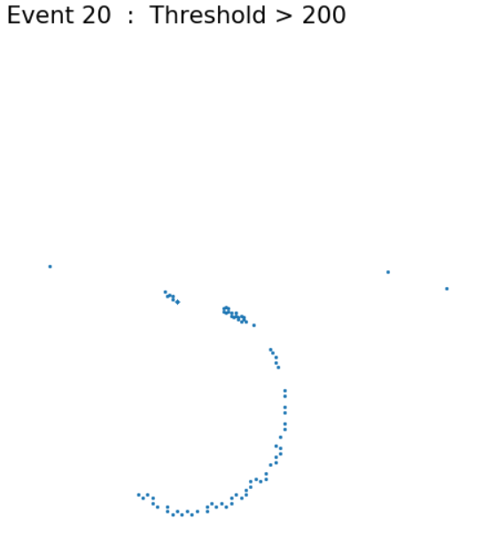

Slide 14
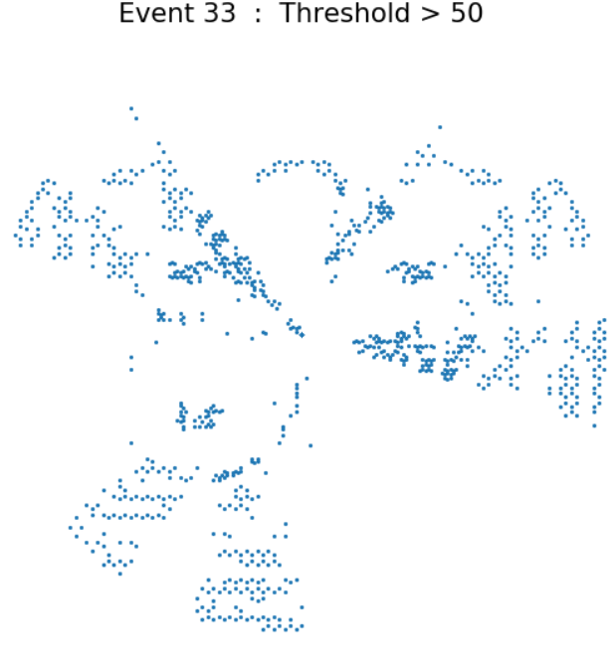
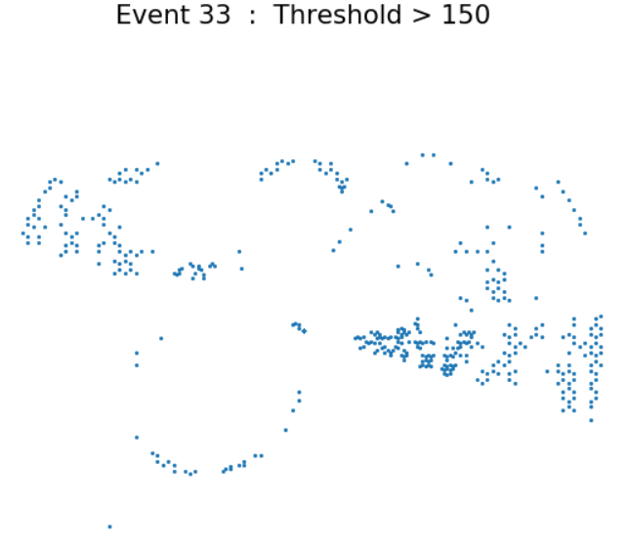
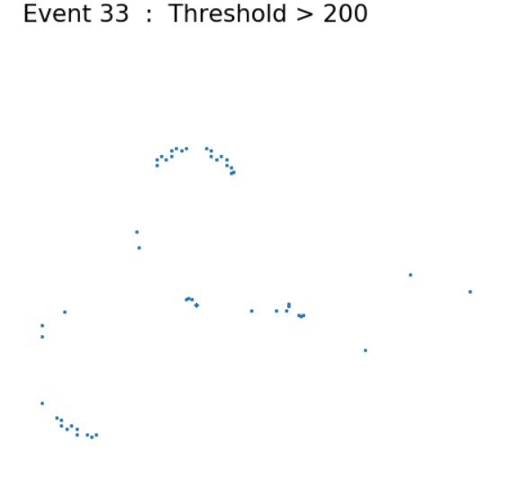

Slide 15
Next Step
Pytpc takes the peak value of each trace but with the different charge normalization across the pads in this experiment, the peak difference should be recorded for plotting
Moving forward I will manually calculate the peak difference to see if it enhances the plot to reveal more fleshed out alpha spirals

